Slide 1

Ultrarunning Analysis
By: Hanz Dela Cruz

Slide 2
Background information and variables
The dataset in this project is collected by Eric Samtleben.
The dataset collects information about athletes: age, sex, personal best 100-kilometer marathon time in hours, personal best 100-kilometer marathon time in hours, the surface of personal best 100-kilometer run time, the sum of elevation in 100-kilometer run time, the average amount of kilometers ran per week, an assessment of intelligence, an assessment of emotional understanding and an assessment of emotional management.
Data types focused on emotional
Data dictionary: https://www.causeweb.org/tshs/datasets/ultrarunning_data_dictionary.pdf
Dataset Website: Ultra-Running – Teaching of Statistics in the Health Sciences (causeweb.org)

Slide 3
Research question:
Could emotional intelligence be utilized as a predictor in determining a valid model for an athlete’s 100-kilometer marathon run time?

Slide 4
Variables used
This experiment will use:
Age (newAge)
Sex (newSex)
Surface of personal best 100km marathon time(newPb_surface)
Sum of positive changes in elevation during 100km marathon (newPb_elev)
Personal best marathon time in hours (newPb100k_dec)
Average kilometers ran per week (newAvg_km)
Assessment of emotional intelligence (newTeique_sf)
Assessment of emotional understanding (newSteu_b)
Assessment of situational management (newStem_b)

Slide 5
Methods used to determine which predictors create the best model
Box-Cox method
Analysis of p-values in the transformed model
Adjusted R-squared
Stepwise Variable selection:
Backward AIC
Backward BIC

Slide 6
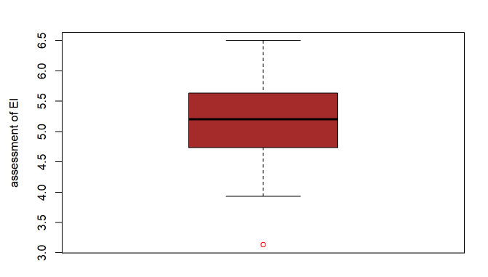
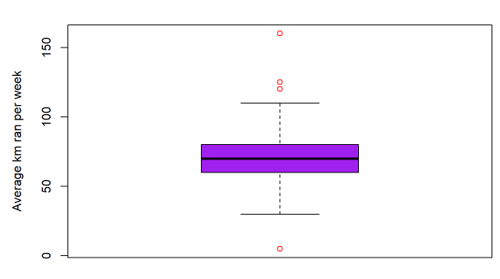
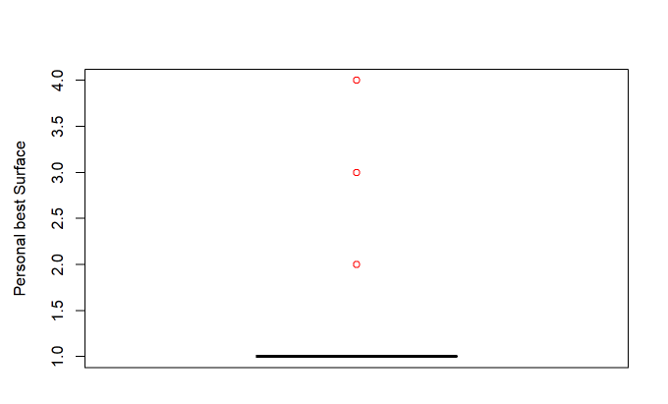
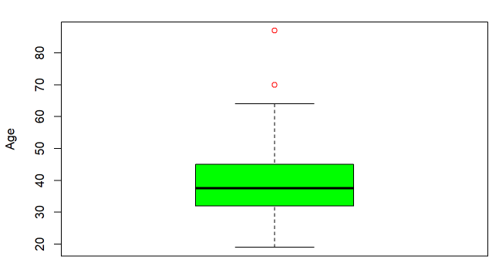
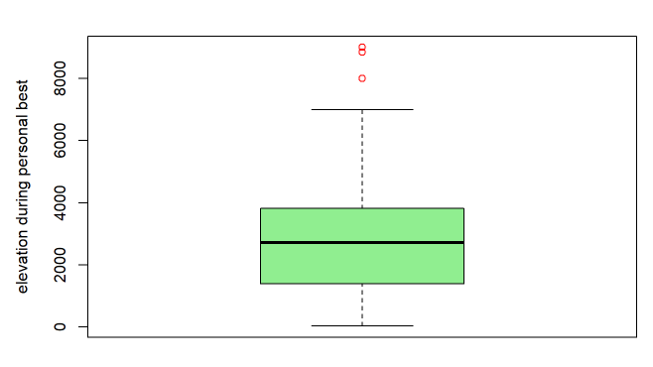
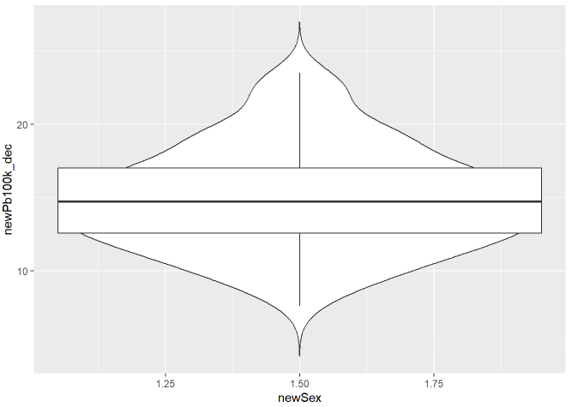
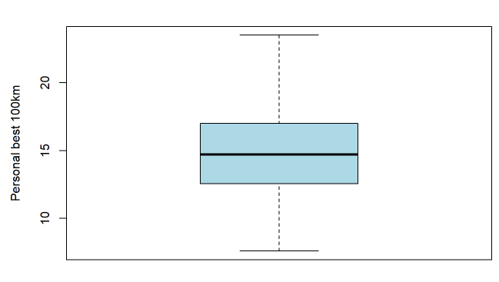
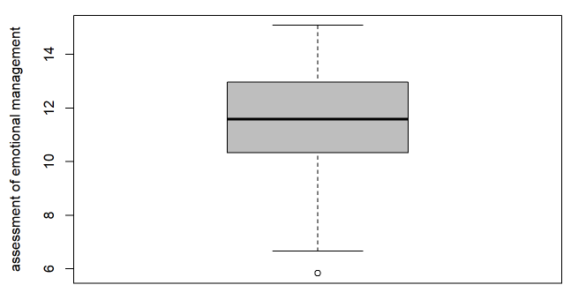
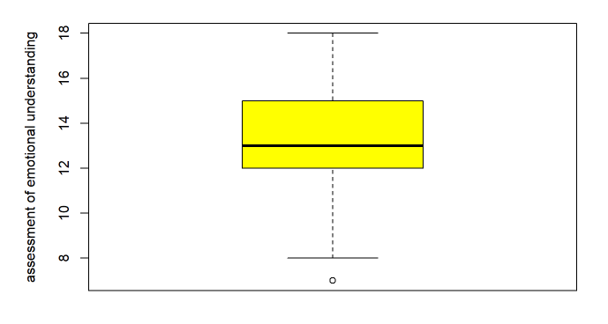
Boxplots

Slide 7
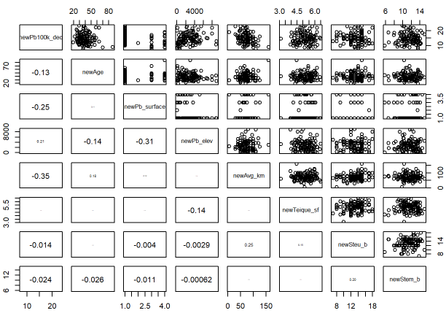
Correlation and pairs plot

Slide 8
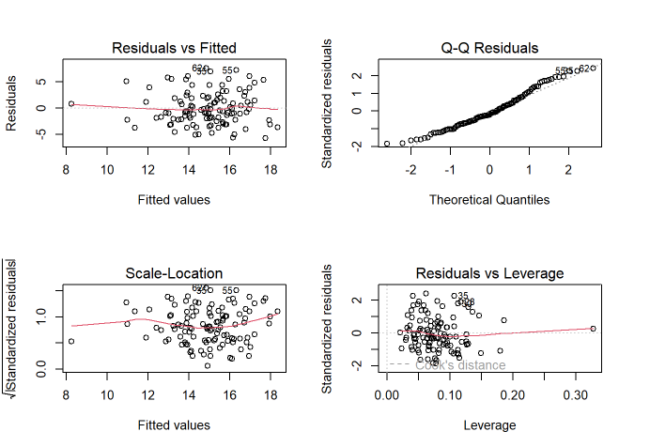
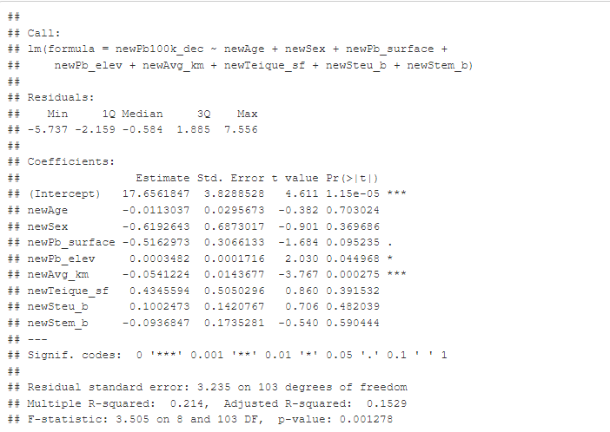
Original model

Slide 9
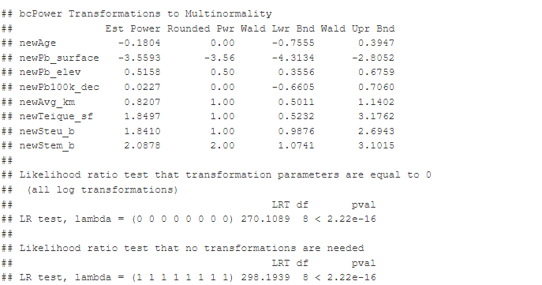
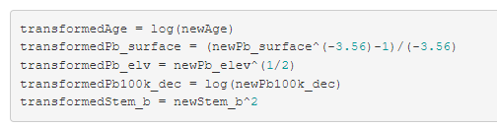
Box-Cox Method

Slide 10
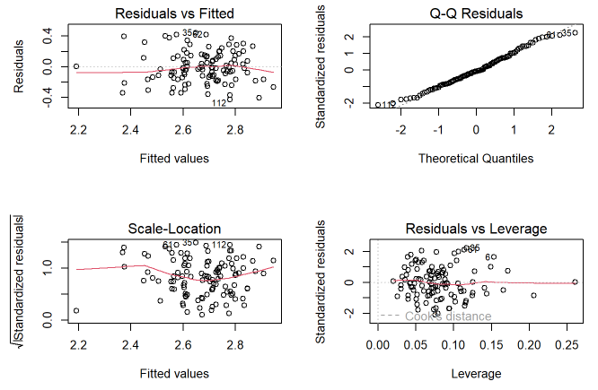
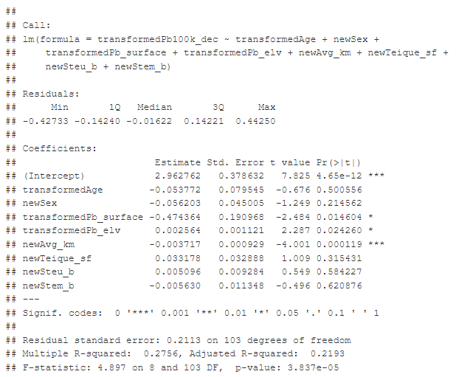
Analysis Of The Box-Cox Method

Slide 11
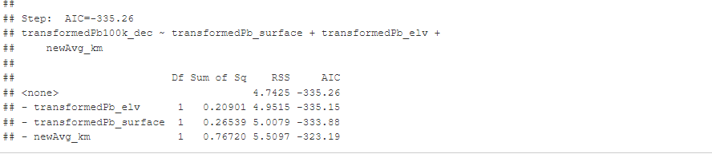
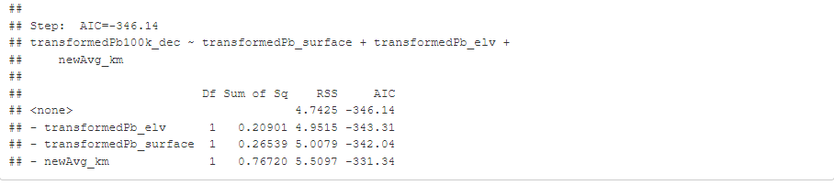
Backward Stepwise AIC and BIC
Backward BIC results:
Backward AIC results:

Slide 12
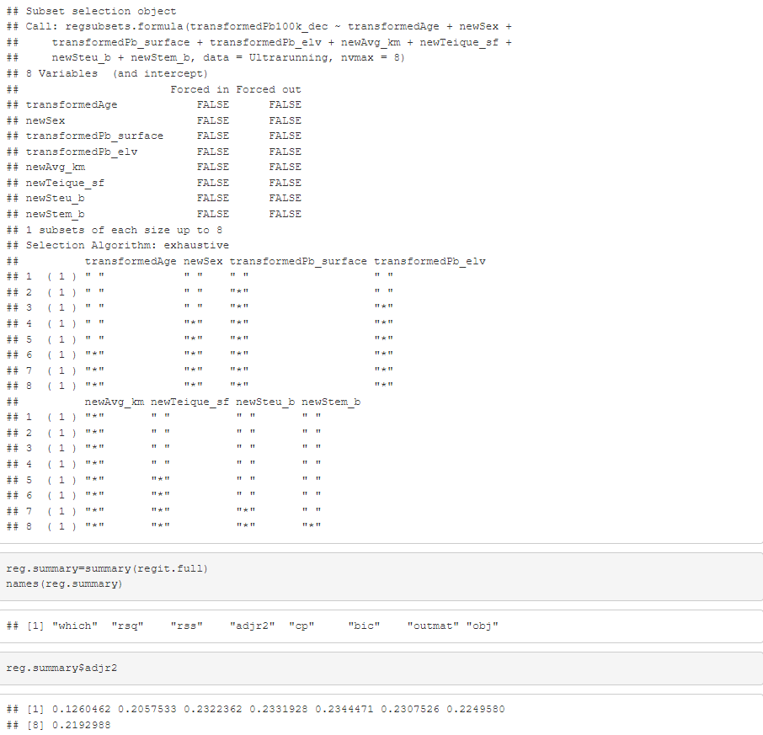
Adjusted R-squared

Slide 13
Analysis of Data
After analyzing the data it’s evident that that the best possible model to determine an athlete’s marathon runtime utilizes the transformed three-variable model that includes the athlete’s elevation during the marathon, the surface the athlete is running on, and the average amount of kilometers.
This was determine based on the BIC, AIC, adjusted R^2 and p-values of the given model.

Slide 14
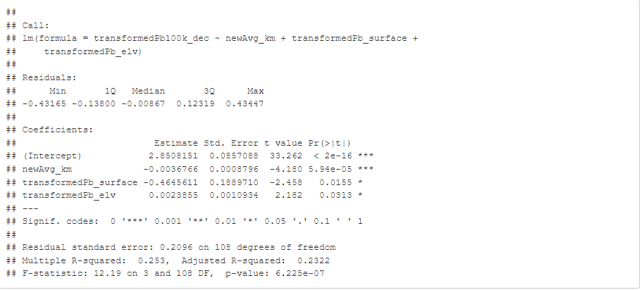
Final Model Summary

Slide 15
Answer to research problem
Although different metrics of emotional intelligence were presented within our data, the data suggested that emotional intelligence cannot be used as a valid predictor in determining an athlete’s 100-kilometer marathon run time.

Slide 16
Weaknesses of the model
A primary weakness the model has is represented through the coefficient of determination( adjusted R^2). Since the coefficient determination has a low R^2 value, the model’s predictors do not explain the variation that results in an athlete’s 100-kilometer marathon run time.
Since the data did show the positive benefits of high levels of emotional intelligence, the data model does not show the true impact of emotional intelligence on an athlete’s run time.

